Slide 1

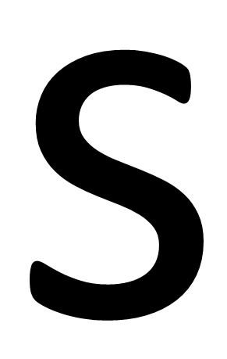

Slide 3


Slide 4
HIT

Slide 5
MISS

Slide 6


